Slide 1
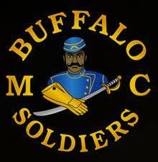
The 9th and 10th Cavalry Buffalo Soldiers
A Five Minute History Brief

Slide 2
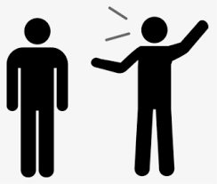

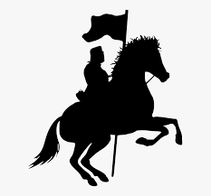
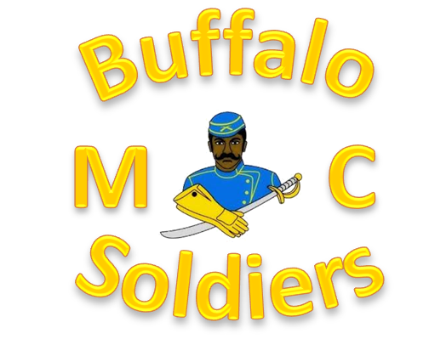


Hey Mister, “What’s a Buffalo Soldier?”
Well… it all started back in 1866….
Army Reorganization Act of 1866
9th and 10th Cavalry and the 24th and 25th Infantry
Black soldier regiments
Name given to 10th Cavalry soldiers by native Americans
Name adopted by other regiments
Regiments “deactivated” starting in 1944
People still identify with/as Buffalo Soldiers after 1944

Slide 3


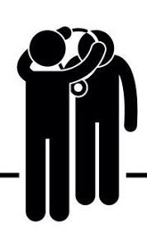

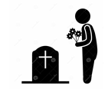
So you aren’t a real Buffalo Soldier?
Nope…
All “real” Buffalo Soldiers are dead
All us of that wear something that says “Buffalo Soldiers” are paying respect and honor to the "real Buffalo Soldiers” that served in those units

Slide 4

Why?
Because of what they did and what they endured…
Superior horsemanship
Proven soldiers
Fought with distinction in numerous campaigns
Professionalism
Low desertion
Racism
Inferior resources
Less pay
White officers

Slide 5

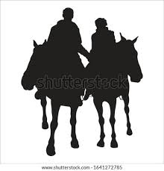
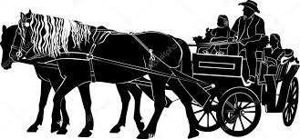
What did they do?
Opened the American West and fought in wars
Secured roads and bridges
Protected railroads and mail routes
Protected settlers during westward expansion
Developed and protected National Parks
Taught riding to cadets at West Point
Fought in many wars and military campaigns

Slide 6


Where did they fight?
In the US, Cuba, Mexico and the Philippines
Indian Wars
American West
Spanish-American War
Santiago Cuba - San Juan Hill with the Rough Riders
Philippine–American War
Conflicted sentiment
Mexican Expedition
Poncho Villa

Slide 7

What about World Wars I and II?
Not deployed as regiments to fight
Buffalo Soldiers not deployed in WW-I
Cavalry deactivated in 1944 leading into WW-II
92nd and 93rd Infantry Divisions formed
Served in France and Italy
WW-I under French command
WW-II in both Pacific and Europe
92nd takes nickname “Buffalo Soldiers”

Slide 8

How are they remembered today?
Through many efforts to preserve their history
Education and Awareness
Monuments, Statues and Dedications
Individual Medals of Honor
Buffalo Soldiers Congressional Gold Medal Act of 2020
People like those of the Buffalo Soldiers Motorcycle Club who proudly take their nickname and honor their legacy
And now… through people like you

